Slide 1
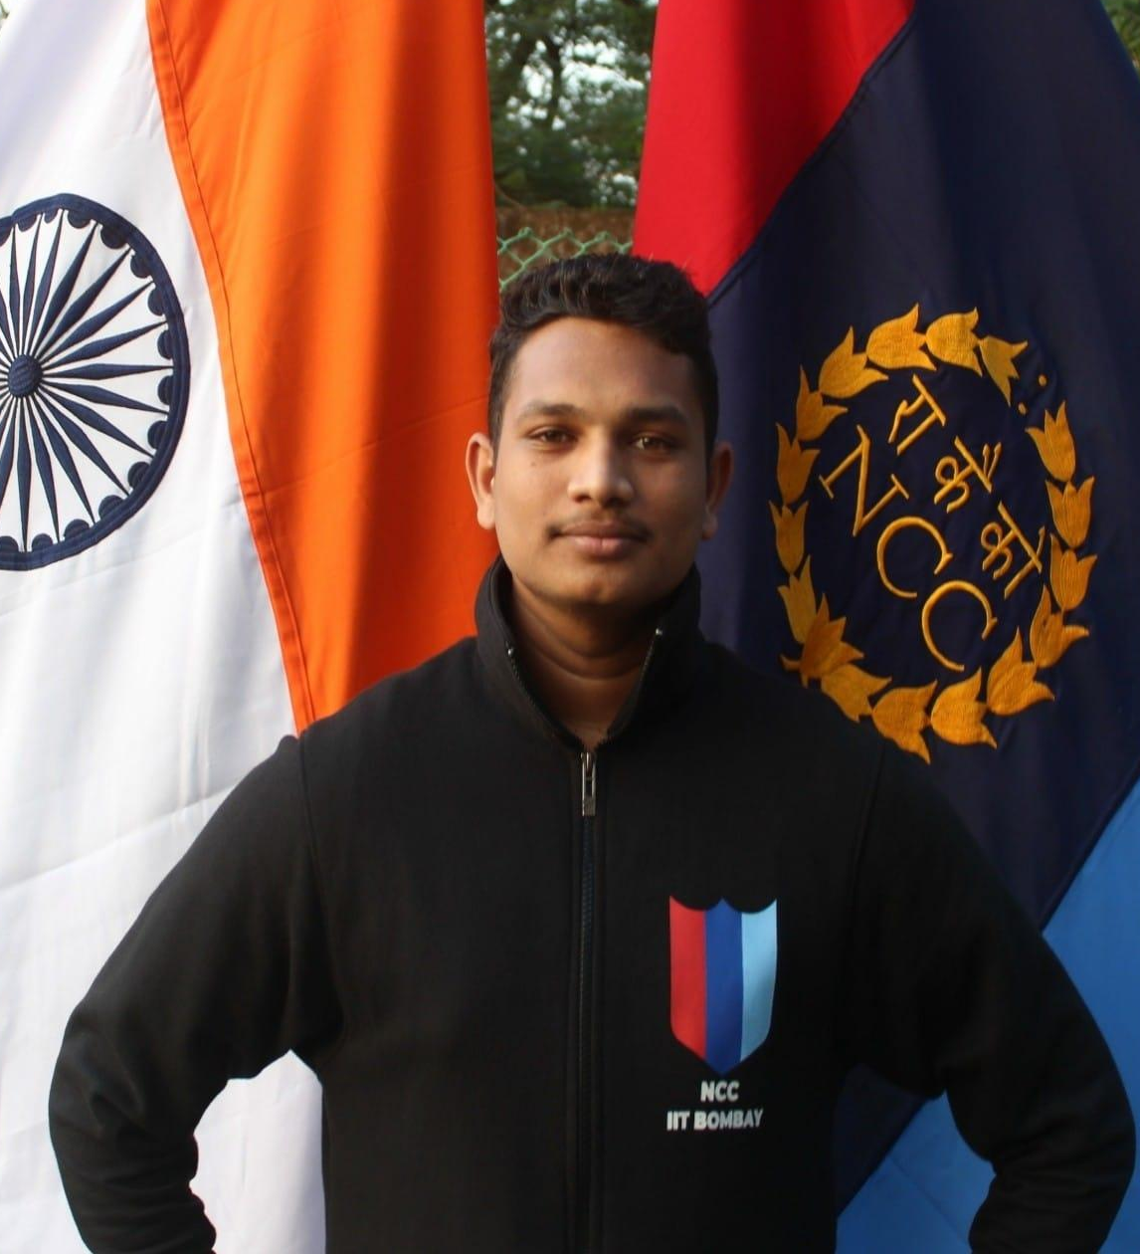
Exploratory Data Analysis: Sports
GRIP at the Sparks Foundation
Business and data analysis internship
Name:- Ashish Dhanve
Email:- ashishdhanve116@gmail.com
Github Link:- https://github.com/ashishdhanve/Task5-IPL-EDA-Grip-at-sparks
Linkedin:- www.linkedin.com/in/ashish-dhanve-99785a14b
This Slide Contains my data analysis solution to the IPL Data provided by the task 5 at GRIP at the sparks Foundation Data Science and Business analytics Intern.

Slide 2
About IPL
The Indian Premier League is a professional Twenty20 cricket league, contested by eight teams based out of eight different Indian cities. The league was founded by the Board of Control for Cricket in India in 2007.

Slide 3
Given Task
This Task Contains the data from 2008-2019(12 Seasons)
Matches.csv:- This file contains teamwise data witch each match.
Deliveries.csv:- This file contains playerwise data with each ball.
Objective of the task:
Perform ‘Exploratory Data Analysis’ on dataset ‘Indian Premier League’
As a sports analysts, find out the most successful teams, players and factors contributing win or loss of a team.
Suggest teams or players a company should endorse for its products.

Slide 4
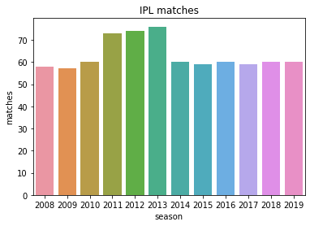
There were total 12 season played between 2008 to 2019
Season6(2013) witnessed highest number of matches(76) followed by season5(2012) & season4(2011)

Slide 5
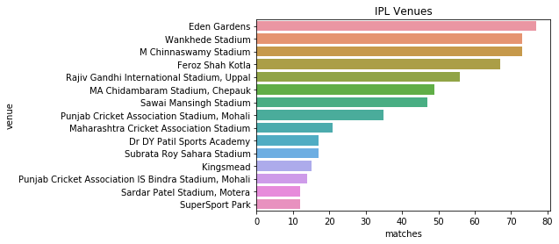
Eden Garden Stadium hosted maximum number of matches(77) followed by Wankhede Stadium (73) and Feroz Shah Kotla (73)

Slide 6
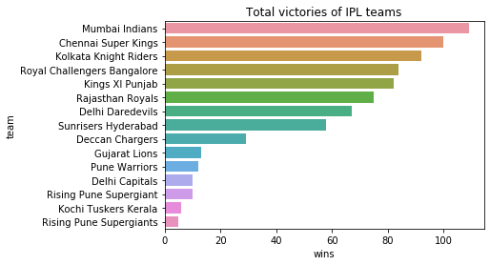

Mumbai Indians Won maximum number of matches (109)
Other teams are:
Chennai Super Kings(100)
Kolkata Knight Riders(92)
Royal Challengers Bangalore(84)

Slide 7
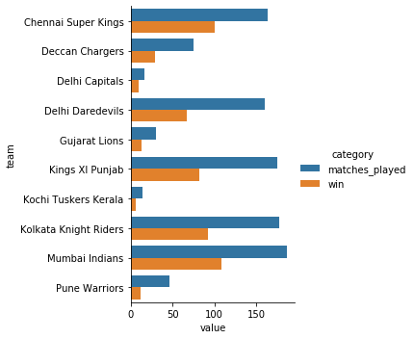
These Plot shows the bars with number of matches played and matches won by each team.
Observations:
Mumbai Indians Played highest number of matches(187) and won 109 matches
Chennai Super Kings played total 167 matches and won 100 matches and having highest winning percentage(60%) among the teams played more than 160 matches

Slide 8
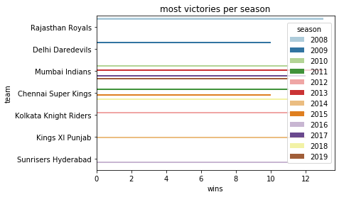
Mumbai Indians has secured the most wins in four seasons(2010, 2013, 2017 & 2019).
Chennai Super Kings is on second number with three seasons(2011,2015 & 2018)

Slide 9
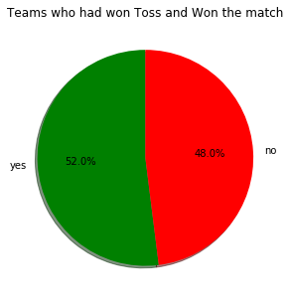
Total Matches Played:- 756
Matches Win When Toss Win:- 393
Matches Win When Toss lose:- 363
The probability of winning when the team had won the toss is 52%. So winning toss gives a slight edge over the opponent. However, it would be naive to term winning the toss as a greater advantage as there were 363 instances when the team losing the toss has won the game.

Slide 10
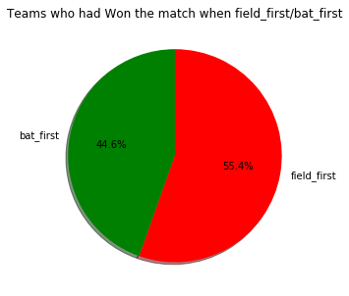
Of the 756 IPL matches played from 2008 to 2019, 419 matches were won chasing the target. Hence, more victories were registered by teams chasing a total(field_first) than defending the total(bat_first).

Slide 11
Team Summary

Slide 12
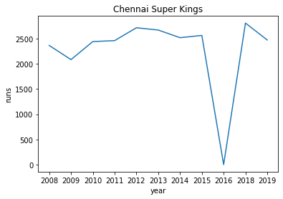

Slide 13
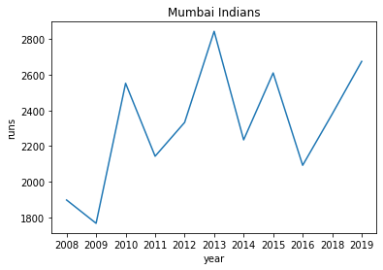

Slide 14
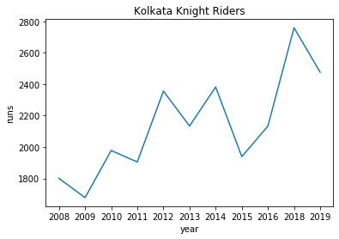

Slide 15
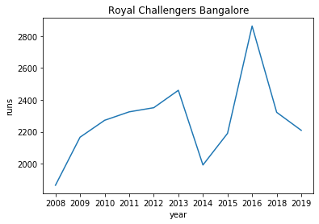

Slide 16
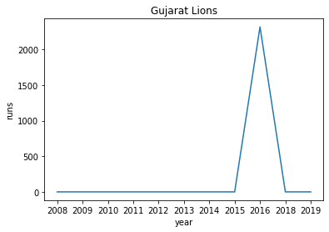

Slide 17
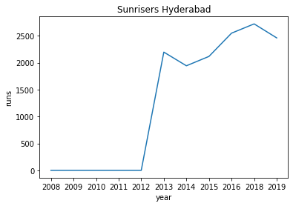

Slide 18
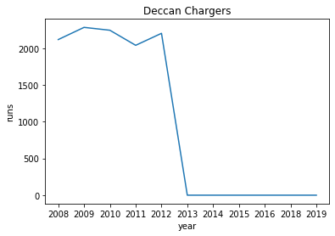

Slide 19
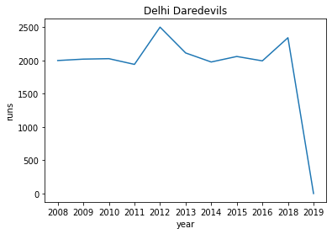

Slide 20
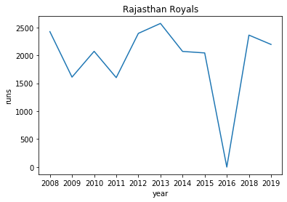

Slide 21
Observation from the plots:
Chennai Super Kings always remain consistent in scoring runs except 2016 when it was banned.
Mumbai Indians started with the low score and gradually started fluctuating between (2000 and 2800 runs) with alternate seasons.
Gujrat Lion played only one season of IPL with total runs more than 2000.
Royal Challengers Bangalore's performance gradually increased and suddenly dropped in 2014 to increase again.
Kolkata Knight Riders performance continuously increasing with seasons.

Slide 22
Batsman Summary

Slide 23
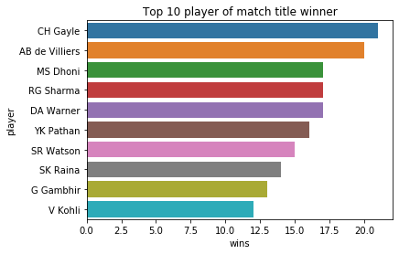
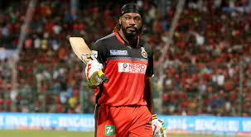
CH Gayle is the player who won the most player of the match awards and hence is the most valuable player.
Six Indian players have figured in the top ten IPL players list.
Chris Gayle and AB de Villiers have never won an IPL. Of the top ten players, 6 players(RG Sharma, MS Dhoni, DA Warner, SR Watson, SK Raina, and G Gambhir) have won the IPL. It exemplifies the importance of the presence of the most valuable player(s) in a team.

Slide 24
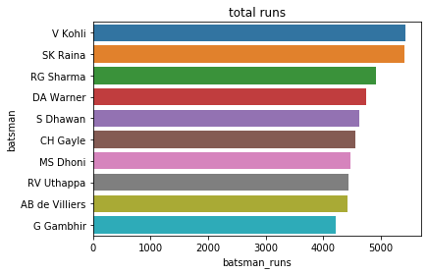
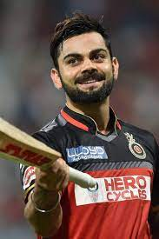
V Kohli is a batsman to score most number of runs (5434) followed by SK Raina (5415) and RG Sharma( 4914)

Slide 25
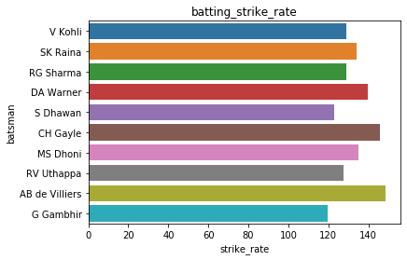
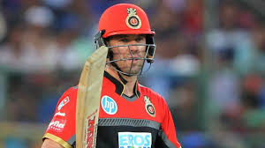
AB de Villiers is the batsman with highest strike rate i.e 148.78 followed by CH Gayle(145.64) and DA Warner(139.52)
Strike Rate = (Number of runs / Number of balls) *100

Slide 26
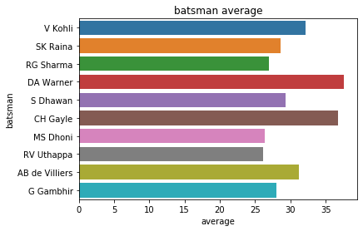
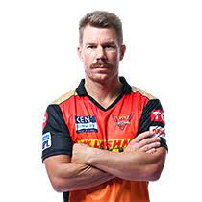
DA Warners is the batsman to have highest batting average(37.62) followed by CH Gayle(36.77) and V Kohli(32.15)

Slide 27
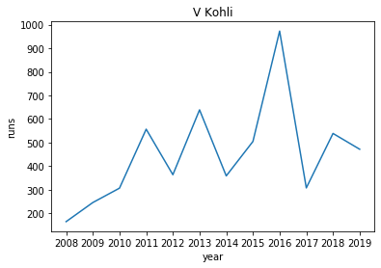

Slide 28
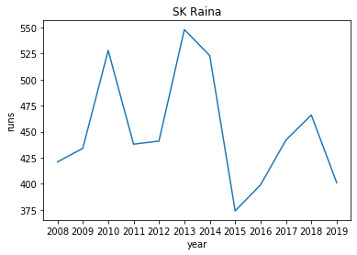

Slide 29
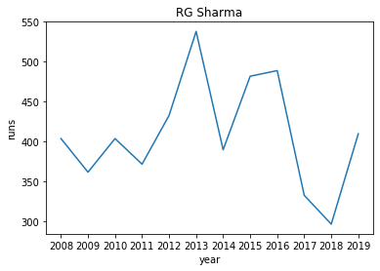

Slide 30
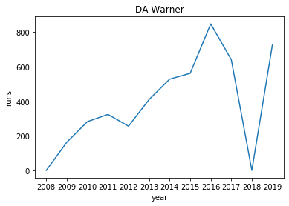

Slide 31
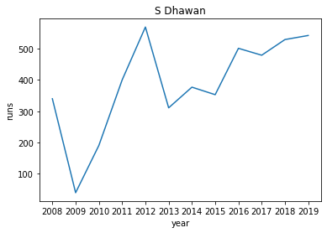

Slide 32
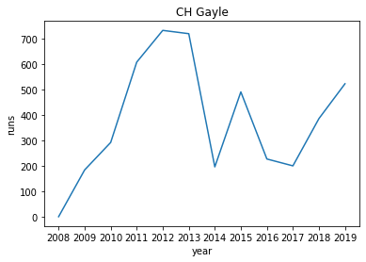

Slide 33
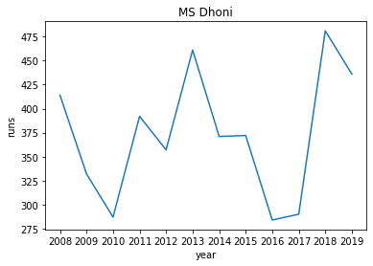

Slide 34
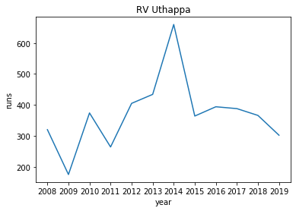

Slide 35
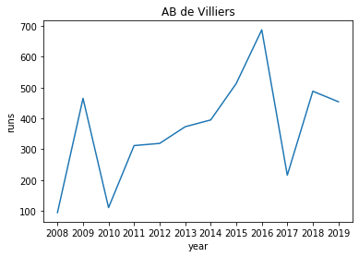

Slide 36
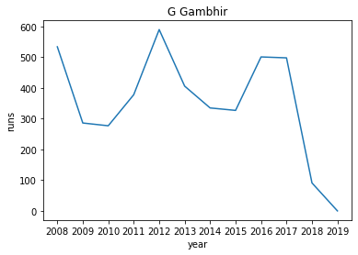

Slide 37
Observation from The Plots:
V Kohli’s performance dropping and rising with alternate seasons, given his best performance in 2016.
DA Warner’s performance continuously increasing with seasons and there is sudden drop in 2019 because of his absence in IPL.
There are sudden drops in the performance of MS Dhoni in 2010 and 2016. His best performance is in 2013
There are sudden and irregular changes in the performances of the player each season.

Slide 38
Bowler Summary

Slide 39
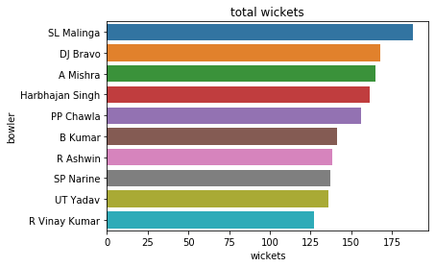
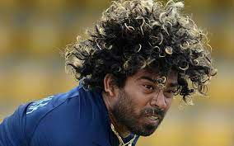
SL Malinga have the honour to take most number of wickets(188) followed by DJ Bravo(168) and A Mishra(165)

Slide 40
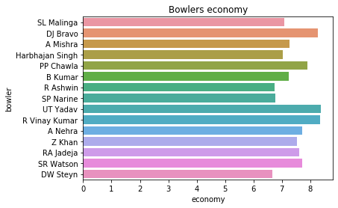
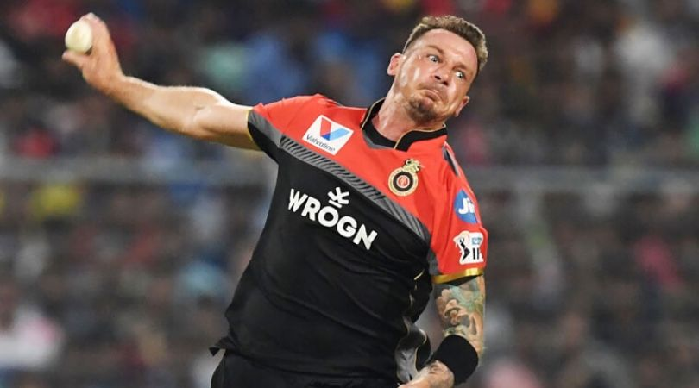
DW Steyn have the lowest economy(6.67) followed by R Ashwin(6.74) and SP Narine(6.78)
Economy is a serious criteria for bowlers,a bowler needs to maintain a low economy.
Economy = runs given / over

Slide 41
Inferences and conclusions:
Mumbai Indians is the most successful team in IPL.
Mumbai Indians has won the most number of toss.
There were more matches won by chasing the total(419 matches) than defending(350 matches).
The Mumbai city has hosted the most number of IPL matches.
Chris Gayle has won the maximum number of player of the match title.
Winning toss gives a slight edge(52%) probability of winning) against the opponents.
Five Indian players have figured in the top ten IPL players list.
Eden Gardens has hosted the maximum number of IPL matches.
Till 2019, 40 venues have hosted 756 IPL matches.

Slide 42
Objectives and solution:
As a sports analysts, find out the most successful teams, players and factors contributing win or loss of a team.
=> Most Successful Teams:
- Mumbai Indians,Chennai Super Kings,Kolkata Knight Riders
=> Most Successful batsman:
- V Kohli, SK Raina, CH Gayle,DA Warners
=> Most Successful Bowler:
- SL Malinga, DJ Bravo, R Ashwin
The Players and Teams discussed above should be consider for endorsement.
Factors Contributing to Win and Loss are discussed in Inference and Observation Section.

Slide 43
Thank You

